Slide 1
Value Mapping
Parameterized Mapping
Extended Receiver Determination
Dynamic receiver determination using Xpath
Bangalore, 27/08/2019, Nagaraju

Slide 2
Value Mapping
The standard function Value Mapping is in the Conversions function group area and you insert it between the source and target fields.
In the Value Mapping function (Conversions -> Value mapping), you can maintain multiple key value pairs externally e.g. you could maintain them in the Integration Directory. These are picked up at the runtime.

Slide 3
Value Mapping
How it’s work?
Now, let us understand how to implement Value Mapping. Maintain a value mapping table in your Integration Directory.
To do this, open your ID(Integration Directory) and go to Tools -> Value Mapping in the menu path.
Display Value Mapping dialog will open up. Specify Agency and Scheme for source and target. These can be any arbitrary string values. Generally, Party or Business system/service names are preferred for agency while namespaces with some text identifier is preferred for scheme.

Slide 4
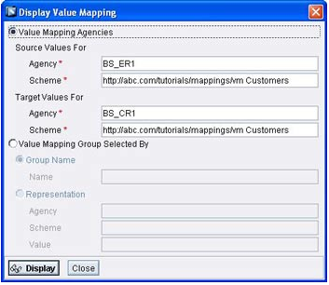
Value Mapping
Click on the Display button. Value mapping table will be displayed. Click on Change button to edit the value mapping table. Specify the source and target values. You can as well specify a Group Name for each value pair

Slide 5
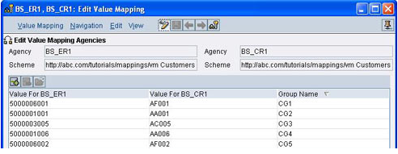
Value Mapping
Groups can be useful if you are maintaining values for more than two systems. For example, the figure above shows a sample value mapping table. A customer 5000006001 in system BS_ER1 refers to customer AF001 in system BS_CR1. Thus these three values would have a common Group Name say CG1. Group names again are arbitrary string values. Save and activate your change list.

Slide 6
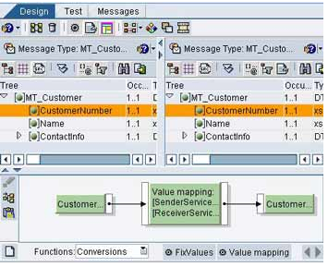
Value Mapping
Now, go to Integration Repository and open the mapping program where you wish to use the above created value mapping. Use the standard function Conversions -> Value mapping to map the desired field from source to target.

Slide 7
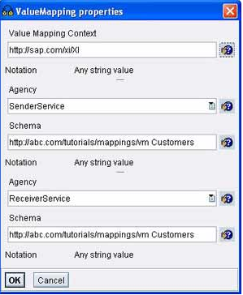
Value Mapping
Double click to define function properties. A sample is shown below
Since we have maintained value mapping in Integration Directory, under Value Mapping Context specify http://sap.com/xi/XI.
Under Agency and Scheme, specify the Agency and Scheme values used in the Integration Directory.
If you have used party or Business system/service names as Agency in ID, you can simply choose SenderParty or SenderService for sender and ReceiverParty or ReceiverService for receiver.
The dropdown box already has these values to choose from. These values get replaced with actual Party/Business system/service names at runtime

Slide 8
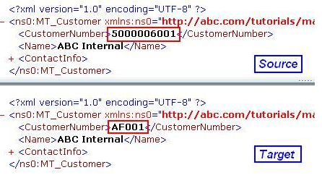
Value Mapping
When you locally test the mapping in the IR, you will not be able to see the actual result since values are picked from ID at runtime.
Only when you execute the scenario, you will see the transformed values.
The image above shows source and target XML that has been transformed via Value Mapping

Slide 9
Parameterized Mapping

Slide 10
Parameterized Mapping
Parameterized mapping is a great way to leverage your mapping program to have multiple applications. SAP introduced this technique first in SAP PI version 7.1. Parameterized mapping allows you to transfer values to mapping program or values from the mapping program. Similar to how we use import and export parameters in a function, parameters can be added to SAP PI/PO mapping programs using parameterized mapping technique.
Parameterized mappings are supported in Graphical Message Mappings, Java Mappings and XSLT Mappings

Slide 11
Parameterized Mapping
Types of Parameters in Parameterized Mapping:
Import: Values can be passed to mapping program using import parameters before the mapping program is executed. Values for import parameters can be assigned from transformation steps or interface determination.
Export: Export parameters allow us to transfer values from the mapping program after it has been executed by the integration pipeline process or by monitoring. You can only assign values to Export parameters using User Defined Functions (UDF)

Slide 12
Parameterized Mapping
Categories of Parameters in Parameterized Mapping:
Simple Type: Simple types can be used as either import or export parameters. Data types of parameters of Simple Type are xsd:string and xsd:integer
Adapter: Parameter category “Adapter” can be only used as an Import parameter. Adapter parameters are mainly used when you are implementing a mapping lookup. For example, in a JDBC look up scenario you can set the JDBC communication channel name which is used for JDBC look up function in the interface determination

Slide 13
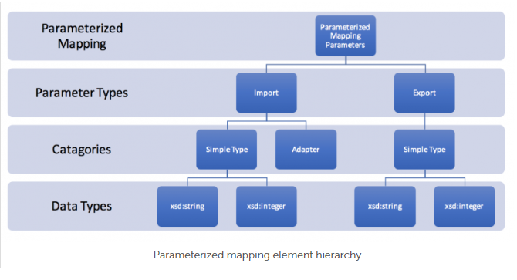
Parameterized Mapping

Slide 14
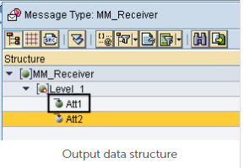
Parameterized Mapping
Step by Step Guide on Parameterized Mapping Configuration:
Lets create a simple file to file scenario with two parameters. We will use the import parameter “Parameter_1” to assign a value to output data structure field “Att1“. Value for import parameter “Parameter_1” will be maintained in the Integration Configuration Object (ICO) at design time of Integration Directory

Slide 15
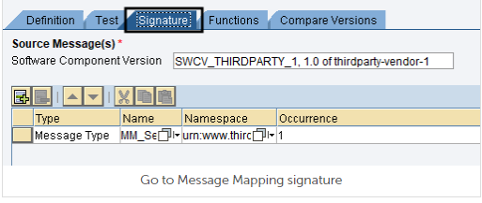
Parameterized Mapping
Step 1 – Create Parameters in Mapping Program
Go to Signature tab of the mapping program and create parameters

Slide 16
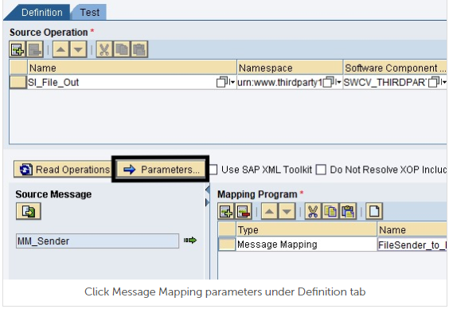
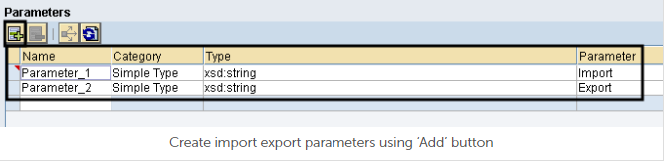
Parameterized Mapping
Here I have created two parameters but we will only be using import parameter “Parameter_1“.

Slide 17
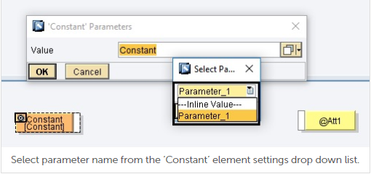
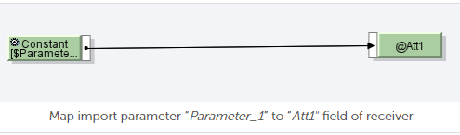
Parameterized Mapping
Step 2 – Map the Import Parameter to Required Output Field
Graphical mapping element constant can be used to assign import parameter to required output element. Select properties of constant mapping element to select the parameter name from the drop down menu.

Slide 18
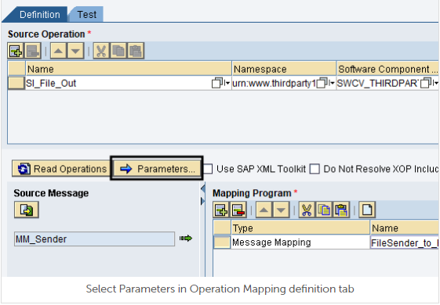
Parameterized Mapping
Step 3 – Create Parameters in Operation Mapping.
Since massage mapping is executed by PI/PO runtime through a corresponding Operation Mapping, we need to create parameters in Operation Mapping and bind them or map them to message mapping parameters.

Slide 19
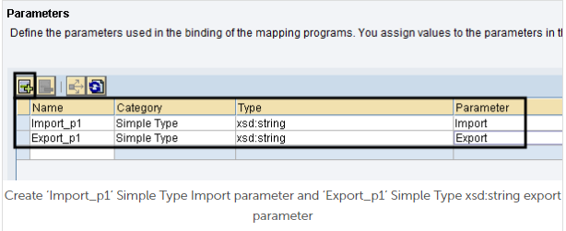
Parameterized Mapping
Again, we will be creating two parameters, but we’ll only use “Import_p1” import parameter for this example

Slide 20
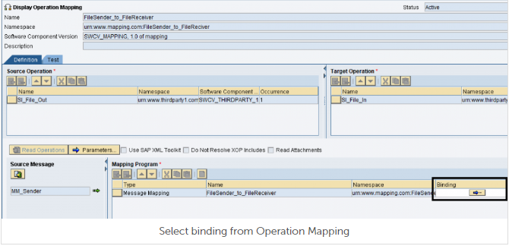
Parameterized Mapping
Step 4 – Bind Operation Mapping Parameters with Message Mapping Parameters.
Select binding and map Operation Mapping parameters with Message Mapping Parameters.

Slide 21
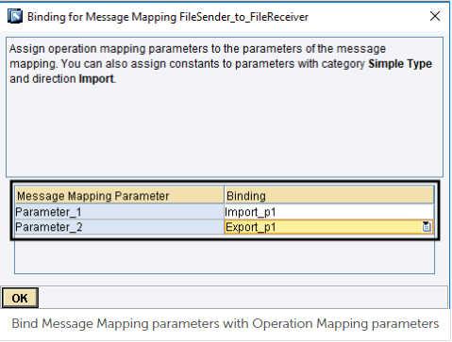
Parameterized Mapping
Map Message Mapping parameters with Operation Mapping parameters

Slide 22
Parameterized Mapping
Step 5 – Set Value to Import Parameter at Design Time.
Go to Integration Directory and assign a value to import parameter in Integration Configuration Object (ICO) or Receiver Determination (in dual stack).
In Single stack version of PI or PO, parameters can be accessed under the Receiver Interfaces tab of Integration Configuration Object (ICO).
Let’s assign constant value “10” to import parameter “Import_p1” which is mapped to Message Mapping parameter “Parameter_1”.

Slide 23
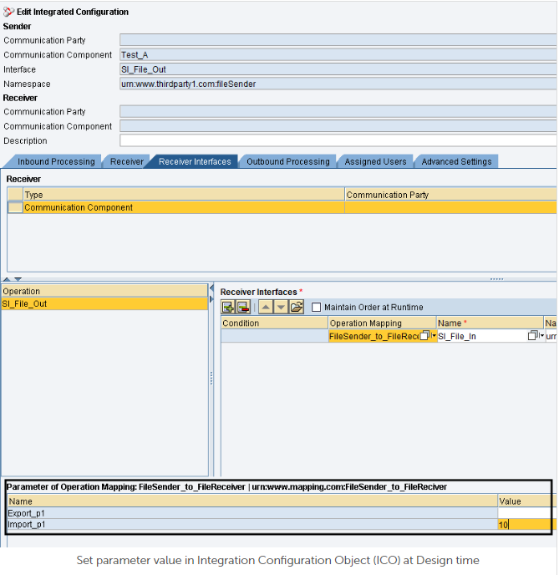
Parameterized Mapping

Slide 24
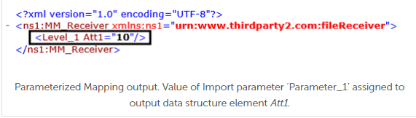
Parameterized Mapping
Output

Slide 25
Extended Receiver Determination

Slide 26
Extended Receiver Determination
Extended or Dynamic Receiver Determination is useful when it comes to determining message receivers at interface runtime by evaluating the content of the sender message using complex logics.
Therefore, the main advantage of Extended Receiver Determination is that it facilitates complex logic-based receiver evaluation at runtime.

Slide 27

Extended Receiver Determination
Step by Step Guide on How to Create an Extended Dynamic Receiver Determination
I have chosen a simple logic since the main purpose of the article is to show the functionality of the Extended Receiver Determination to avoid creating complex Message Mapping. Let’s assume we have an XML file which sends two integer values (value1 and value2) and if the sum of these two values is greater than 10, message should be send to receiver ‘Test_A’ else to ‘Test_B’.

Slide 28
Extended Receiver Determination
Prerequisites:
The objects under software component ‘SAP BASIS’, namespace ‘http://sap.com/xi/XI/System’ should be available in Enterprise Service Repository (ESR).
Data Type: Receivers
Message Type: Receivers
Service Interface: ReceiverDetermination

Slide 29
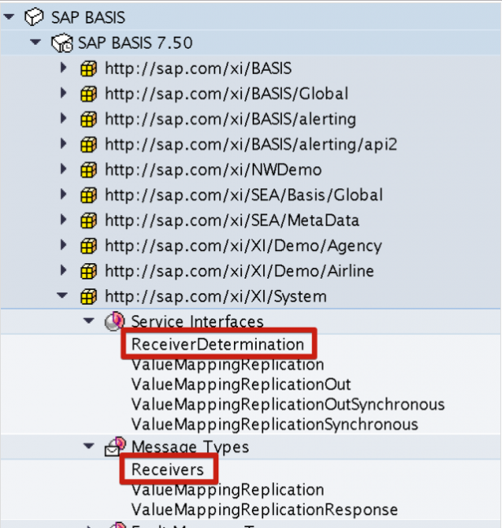
Extended Receiver Determination

Slide 30
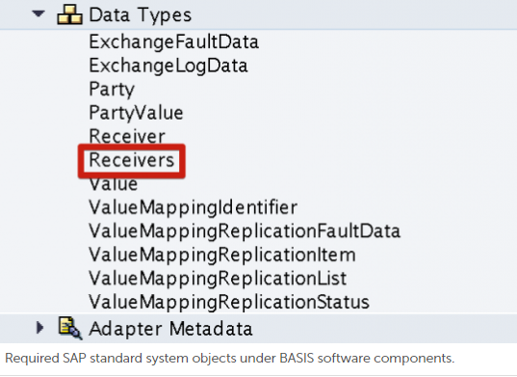
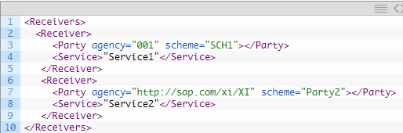
Extended Receiver Determination
We use data type ‘Receivers’ to populate the list of dynamic receivers determined at runtime

Slide 31
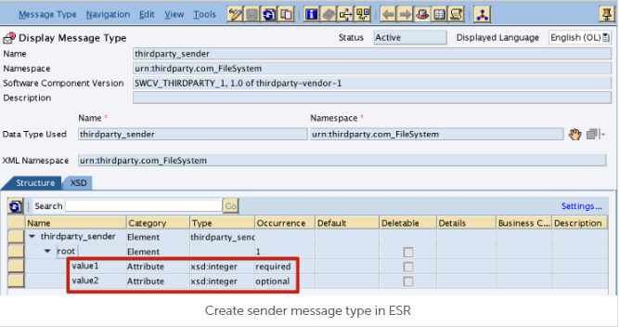
Extended Receiver Determination
Steps in Enterprise Service Repository (ESR)
Step 1: Create Data Type for input XML file format.
Step 2: Create Input Message Type.

Slide 32
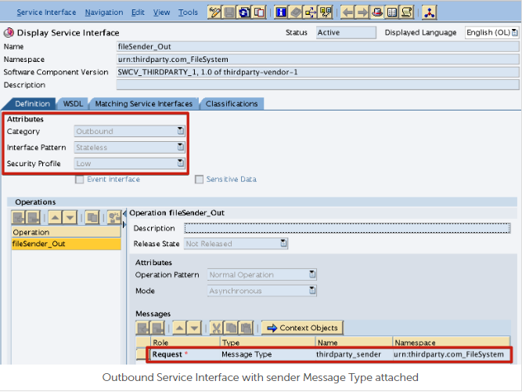
Extended Receiver Determination
Step 3: Outbound Service Interface Configuration.

Slide 33
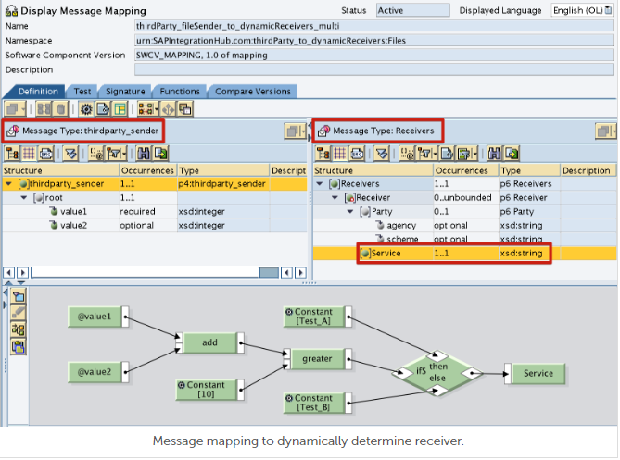
Extended Receiver Determination
Step 4: Dynamic Receiver Determination Message Mapping

Slide 34
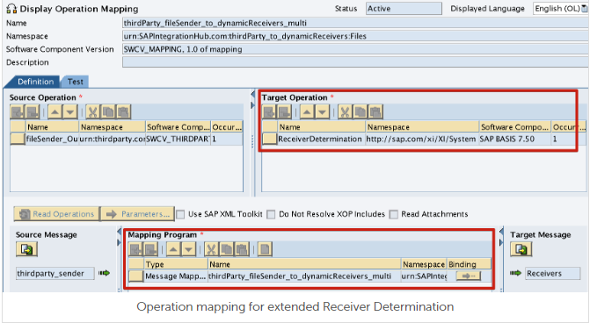
Extended Receiver Determination
Step 5: Create Dynamic Receiver Determination Operation Mapping.
Dynamic receiver determination’s target operation should be ‘ReceiverDetermination’ inbound interface under namespace http://sap.com/xi/XI/System of BASIS software component

Slide 35
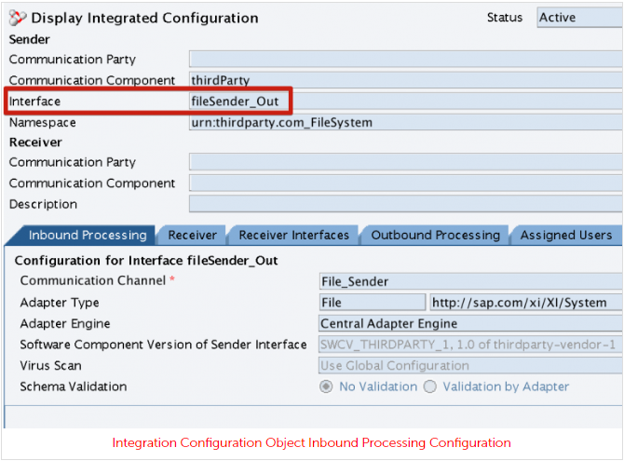
Extended Receiver Determination
Steps in Integration Directory (ID).
Step 6: Configure Inbound Processing.

Slide 36
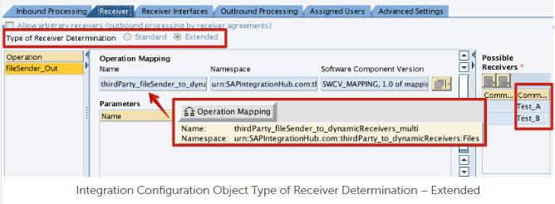
Extended Receiver Determination
Step 7: Configure Extended Receiver Determination.
Check the option Extended in Type of Receiver Determination, then assign the Receiver Determination Operation Mapping we created in step no 5. Finally, list the possible receivers.

Slide 37
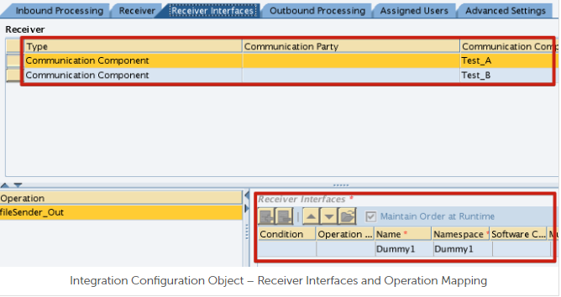
Extended Receiver Determination
Step 8: Set receiver Interfaces and Operation Mappings.
Configure Receiver Interfaces and Operation Mappings for each receiver. Since I am not transforming the input XML file in this example, I have used Dummy Interfaces. But if you are required to transform the message to different formats, create operation mappings and message mappings accordingly.

Slide 38
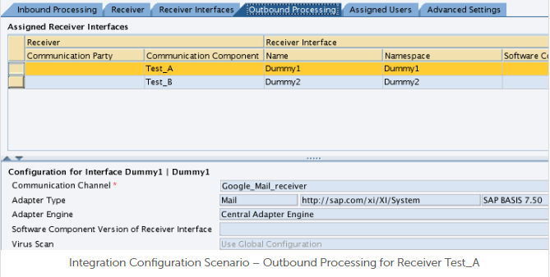
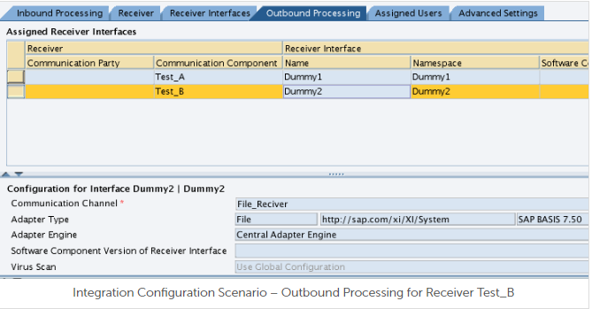
Extended Receiver Determination
Step 9: Configure Outbound Communication Channels.

Slide 39

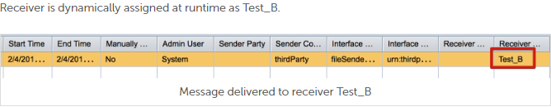
Extended Receiver Determination
Test Integration Configuration Scenario
When total is less than 10.

Slide 40

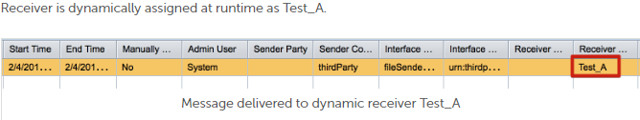
Extended Receiver Determination
Test Integration Configuration Scenario
When total is greater than 10

Slide 41
Dynamic receiver determination using Xpath

Slide 42
Dynamic receiver determination using Xpath
Xpath expressions in SAP PI/PO. When creating Xpath based (Content Based) Receiver Rules or Receiver Conditions in Integration Directory.
we can do to the XPATH expressions that we use in the condition editor during Receiver Determination
In receiver determination various Xpath expressions used to find out the receiver.

Slide 43
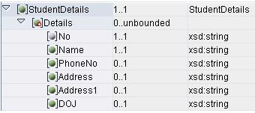
Dynamic receiver determination using Xpath
Source Structure:
I want to send the file according to the Name field
If I want to send the file according to the first 2 character of Name .
First we need to go to condition editor in the receiver determination

Slide 44
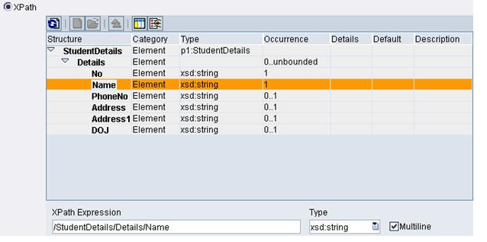
Dynamic receiver determination using Xpath
Select the xpath. Edit it manually according to our requirement.
In the express editor select the Xpath condition

Slide 45
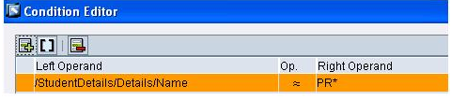
Dynamic receiver determination using Xpath
In the condition editor select the Contains Pattern (CP) .give the first 2 character what you needed. After that use * operator. CP will check the first 2 character exactly equals to the value which we maintained.
Name is contains PR* exits in the source file then the file will send to the receiver.

Slide 46
Thank You

